Slide 1
Medical Image Seminar
Luyue Shi
April 16, 2020

Slide 2
(MICCAI2019)
NoduleNet: Decoupled False Positive Reduction for Pulmonary Nodule Detection and Segmentation
Hao Tang^{1,2}, Chupeng Zhang², and Xiaohui Xie¹
1.Department of Computer Science, Univeresity of California Irvine
^{2.Deep Voxel Inc.}

Slide 3
Introduction
Topic
End-to-end 3D DCNN to solve nodule detection, false positive reduction and nodule segmentation jointly in a multi-task fashion

Slide 4
Introduction
Problems
Handling each task completely independent:
time-consuming and resource intensive
performance may not be optimal, because separately training several systems prevents communication between each other and learning intrinsic feature representations.
Naive implementation of multi-task learning:
because of the mismatched goals of localization and classification, it may be sub-optimal if these two tasks are performed using the same feature map.
a large receptive field may integrate irrelevant information from other parts of the image, which may negatively affect and confuse the classification of nodules, especially small ones

Slide 5
Introduction
Key idea
decoupled feature maps for nodule detection and false positive reduction, and
a segmentation refinement subnet for increasing the precision of nodule segmentation.

Slide 6
Model
nodule candidate screening
false positive reduction
segmentation refinement

Slide 7
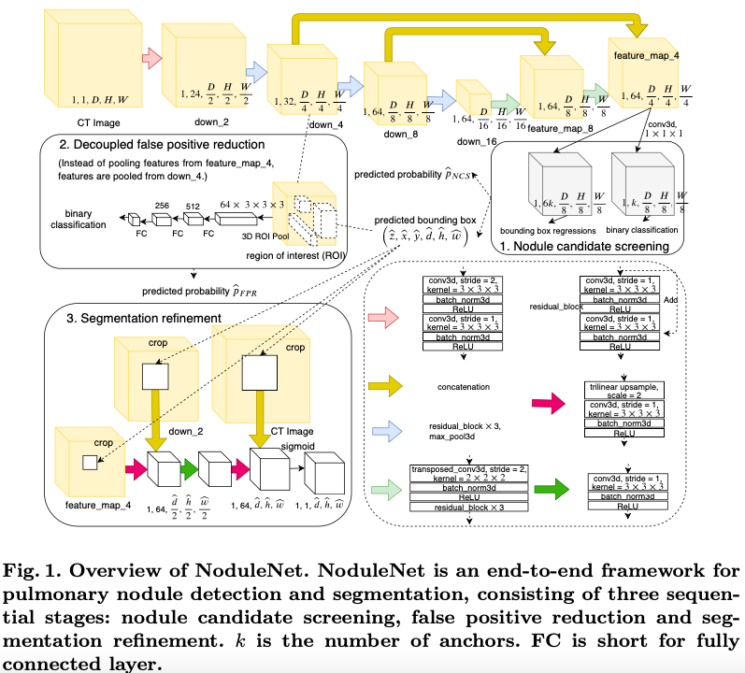
Model

Slide 8
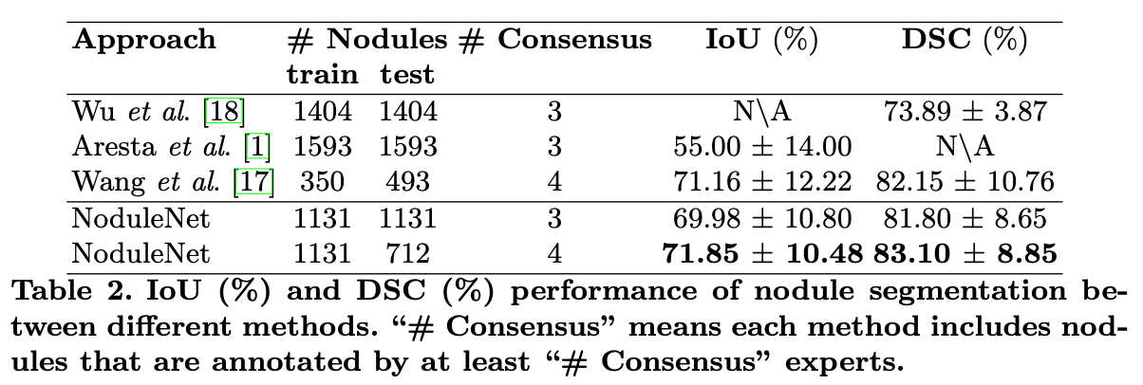
Results
Dataset
Selected from LIDC-IDRI: 586 CT scans with 1131 nodules.
Segmentation

Slide 9
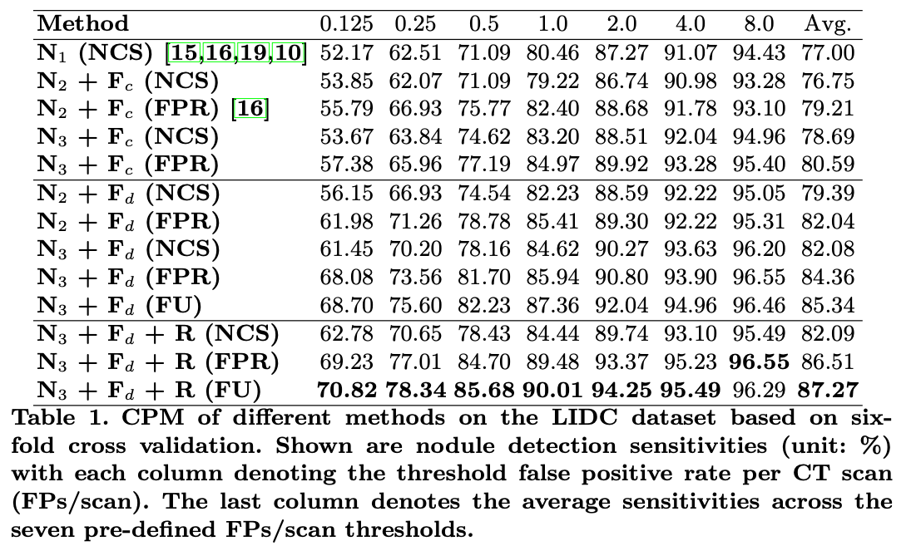
Results
Detection

